Slide 1
Parameter and Return type

Slide 2
Pass Reference and value to Methods
Up to this point, the examples have been using value types, such as int or double, as parameters to methods. However, it is both correct and common to use a reference type as a parameter. Doing so allows an object to be passed to a method.

Slide 3
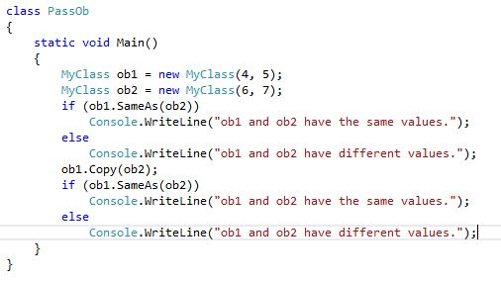
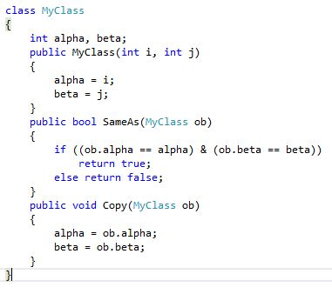

Slide 4
call-by-value
This method copies the value of an argument into the formal parameter of the subroutine. Therefore, changes made to the parameter of the subroutine have no effect on the argument used in the call.

Slide 5
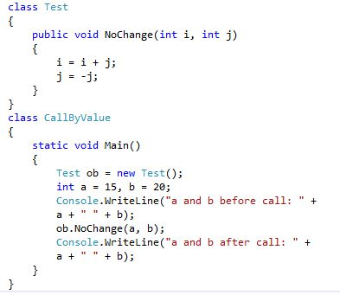

Slide 6
call-by-reference
In this method, a reference to an argument (not the value of the argument) is passed to the parameter. Inside the subroutine, this reference is used to access the actual argument specified in the call. This means that changes made to the parameter will affect the argument used to call the subroutine.

Slide 7
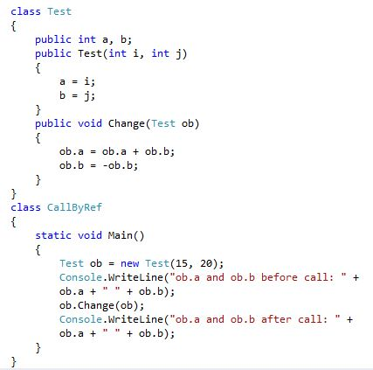

Slide 8
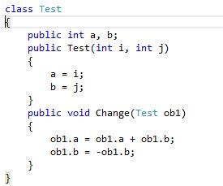
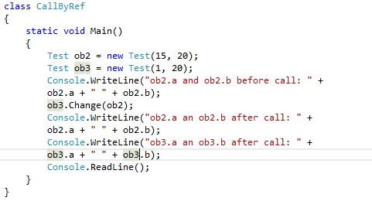

Slide 9
Return Objects
A method can return any type of data, including class types.

Slide 10
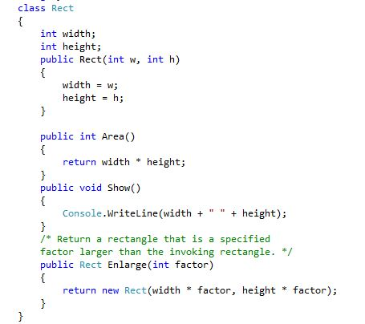
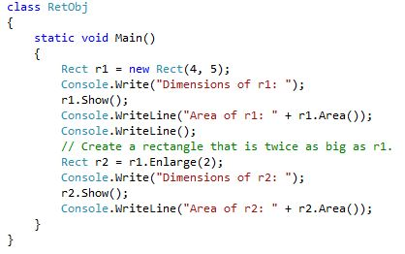

Slide 11
ref parameter modifier
The problem with this scenario is that a ref parameter must be initialized to a value prior to the call. Thus, to use a ref parameter would require giving the argument a dummy value just to satisfy this constraint.

Slide 12
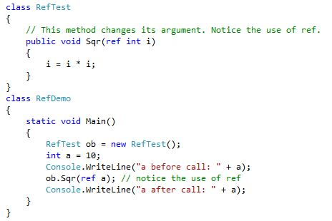

Slide 13
